Slide 1
Programming II
(C Programming Language)
Structures in C
Lecture 16, Wednesday April 07, 2021
Dr. Ayman ALJARBOUH

Slide 2
Outline
Defining a Structure
The Keyword typedef
Passing Structures to Functions
Return Structures from Functions
C Pointers to Structures
Nested Structures
Access Members of a Structure

Slide 3
C Programming Structures
In C programming, a struct (or structure) is a collection of variables (can be of different types) under a single name
Structures are used to represent a record; Suppose, you want to store information about a person: his/her name, citizenship number, and salary. You can create different variables name, citNo, and salary to store this information
A better approach would be to have a collection of all related information under a single name structure and use it for every person

Slide 4
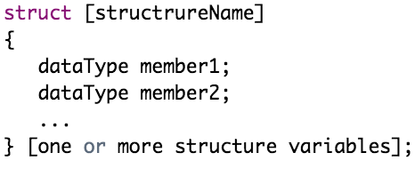
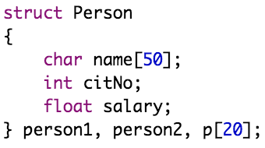
Defining a Structure
To define a structure, you must use the struct statement. The struct statement defines a new data type, with more than one member for your program. The syntax is:
At the end of the structure's definition, before the final semicolon, you can specify one or more structure variables, but it is optional

Slide 5
Outline
Defining a Structure
The Keyword typedef
Passing Structures to Functions
Return Structures from Functions
C Pointers to Structures
Nested Structures
Access Members of a Structure

Slide 6
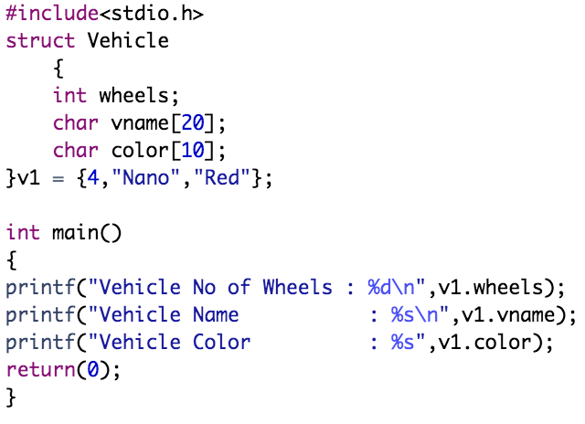
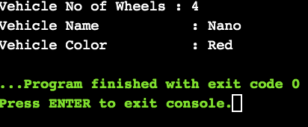
Access Members of a Structure
To access any member of a structure, we use the member access operator (.)
Example:

Slide 7
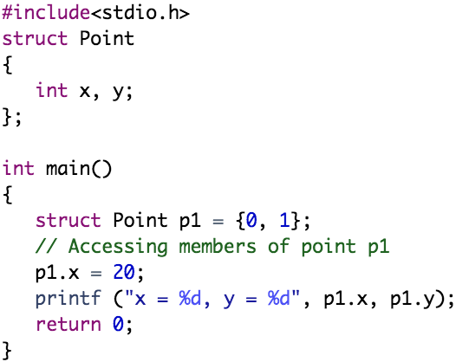
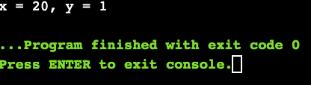
Access Members of a Structure
To access any member of a structure, we use the member access operator (.)
Example:

Slide 8
Outline
Defining a Structure
The Keyword typedef
Passing Structures to Functions
Return Structures from Functions
C Pointers to Structures
Nested Structures
Access Members of a Structure

Slide 9
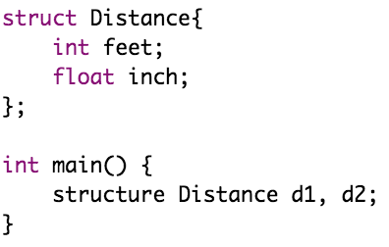
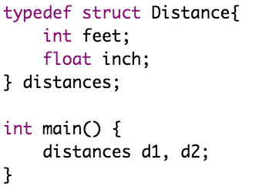
The Keyword typedef
We use the typedef keyword to create an alias name for data types. It is commonly used with structures to simplify the syntax of declaring variables. For example, this code:
is equivalent to

Slide 10
Outline
Defining a Structure
The Keyword typedef
Passing Structures to Functions
Return Structures from Functions
C Pointers to Structures
Nested Structures
Access Members of a Structure

Slide 11
Passing Structures to Functions
You can pass a structure as a function argument in very similar way as you pass any other variable or pointer

Slide 12
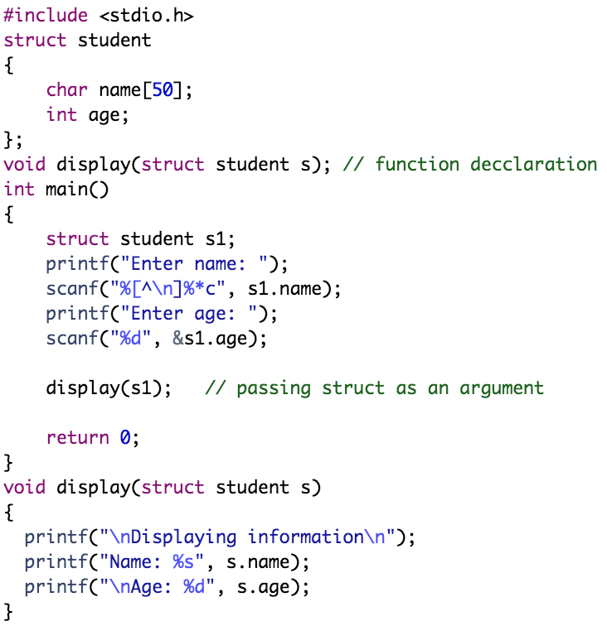
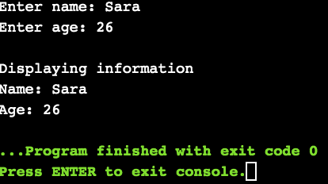
Example:
Here, a struct variable s1 of type struct student is created. The variable is passed to the display() function using display(s1); statement.

Slide 13
Outline
Defining a Structure
The Keyword typedef
Passing Structures to Functions
Return Structures from Functions
C Pointers to Structures
Nested Structures
Access Members of a Structure

Slide 14
Return Structures from Functions
You can return a structure from a function in very similar way as you return any other variable or pointer

Slide 15
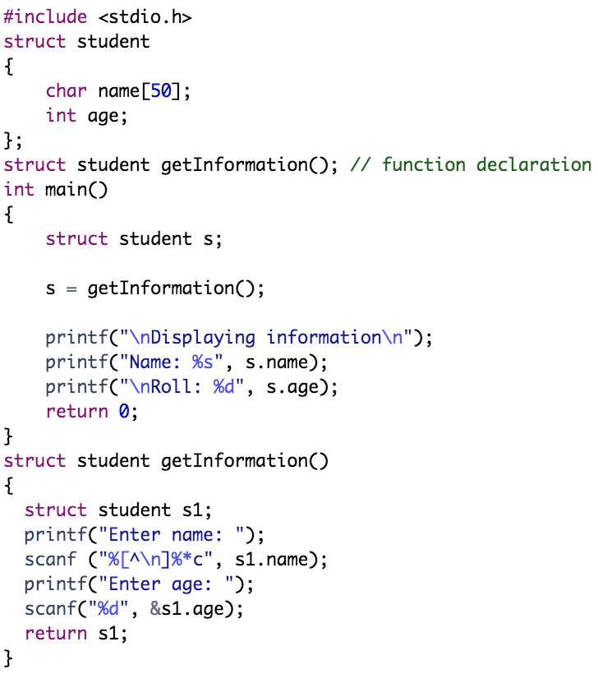
Example:

Slide 16
Outline
Defining a Structure
The Keyword typedef
Passing Structures to Functions
Return Structures from Functions
C Pointers to Structures
Nested Structures
Access Members of a Structure

Slide 17
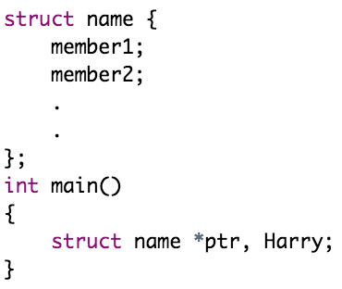
C Pointers to Structures
You can define pointers to structures in very similar way as you define pointer to any other variable. Here's how you can create pointers to structures
Here, ptr is a pointer to struct. To find the address of a structure variable, place the & operator before the structure's name. To access the members of a structure using a pointer to that structure, you must use the -> operator.

Slide 18
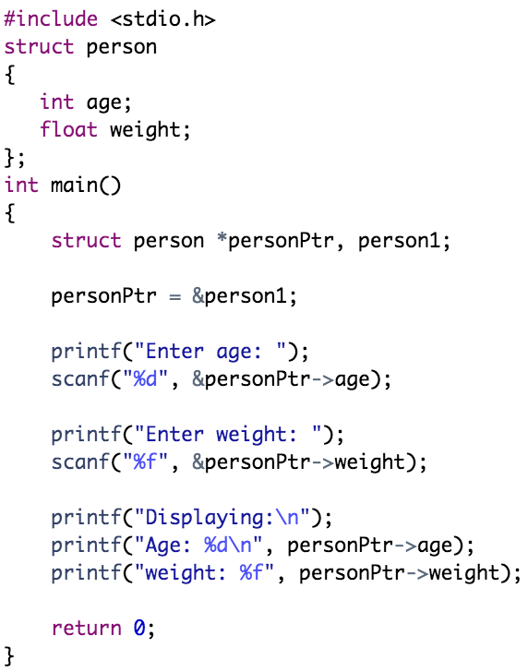
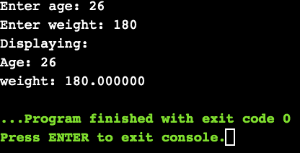
Example:
Note: In this example, personPtr->age is equivalent to (*personPtr).age

Slide 19
Example:
Note: In this example, personPtr->weight is equivalent to (*personPtr).weight

Slide 20
Outline
Defining a Structure
The Keyword typedef
Passing Structures to Functions
Return Structures from Functions
C Pointers to Structures
Nested Structures
Access Members of a Structure

Slide 21
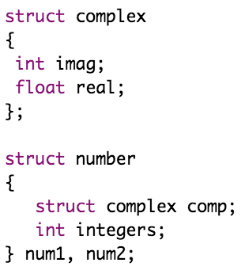

Nested Structures
You can create structures within a structure in C programming. For example,
Suppose, you want to set imag of num2 variable to 11. Here's how you can do it:

Slide 22
Practical Exercises
Write and Compile the following C programs:
Program 1:

Slide 23
Practical Exercises
Write and Compile the following C programs:
Program 2:

Slide 24
Program 3:

Slide 25
Program 4:

Slide 26
Program 5:

